Slide 1
(e)Book Snapshot: Print and eBook Use in an Academic Library Consortium
Joanna Voss
Collections Analyst
OhioLINK

Slide 2
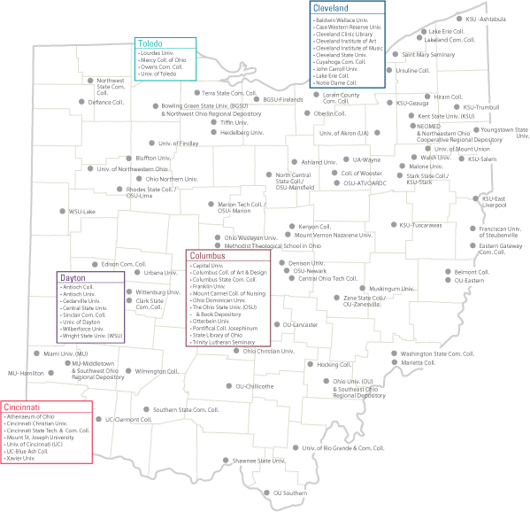
OhioLINK is Member-Driven
121 member libraries
Diverse academic libraries:
Public universities
Two-year and technical colleges
Private colleges & universities
5 ARL libraries
State Library of Ohio
Law and medical libraries
Services:
Shared eResources:
eBooks
eJournals
Databases
Shared collections via courier
Central catalog, theses & dissertations, discovery layer, link resolver

Slide 3
The Big Question
What can we do to continue to meet the needs of students and faculty through the print to electronic book transition?
Are there any use patterns that will help us navigate the transition?
eBook by Jamals Cascio. Retrieved from: https://flic.kr/p/nLo69W
CC BY 2.0

Slide 4
Case Study
Big question!
Case study with Oxford University Press print books & eBooks during 2014
Shared Oxford Scholarship Online (OSO) eBook
Dual access at OSO website and locally loaded in Electronic Book Center (EBC)
Shared print via courier

Slide 5
Data Sources
Print circulation data from the central catalog
Filled requests
eBook use data from Electronic Book Center (EBC)
Downloads
eBook use data from Oxford Scholarship Online
Section requests
eBook title list from Oxford Scholarship Online

Slide 6
Tools
Data clean-up and reconciliation
Excel
OpenRefine (http://openrefine.org/ )
Data analysis and visualization
Tableau
Print vs. electronic activity
Subject analysis
Use by institution
Snowball (2001) by redjar. Retrieved from: https://flic.kr/p/aZhJF
CC BY-SA 2.0

Slide 7
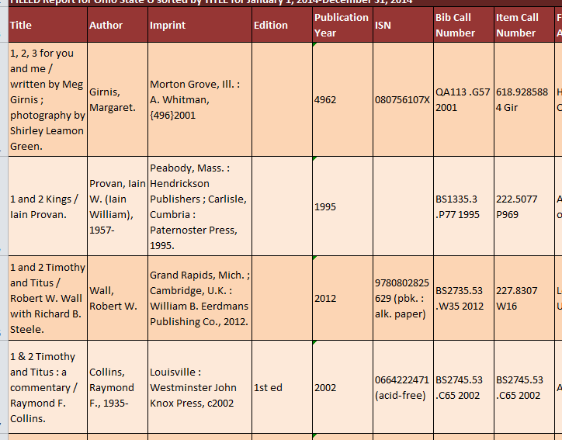
OpenRefine
Useful for messy catalog data!

Slide 8
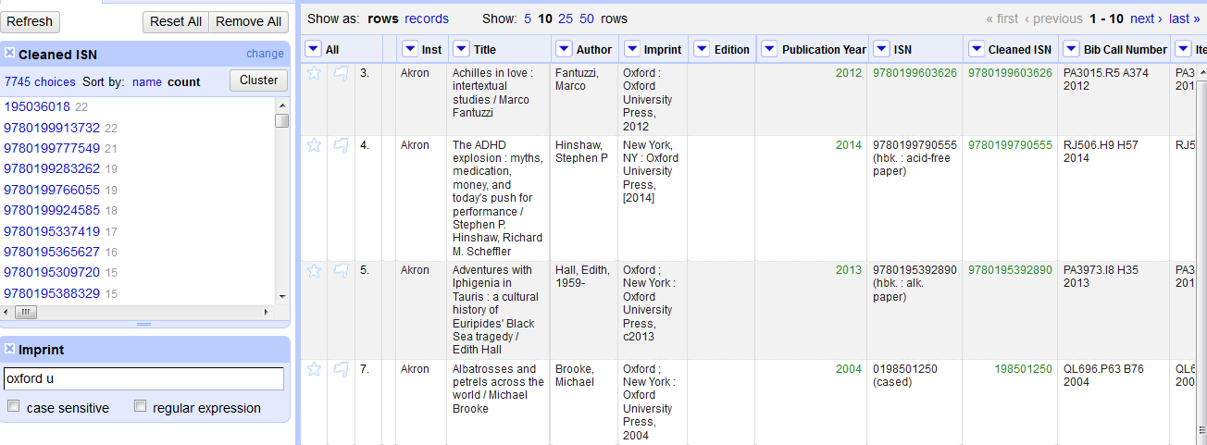
OpenRefine
Clean ISBN
Filter by publisher

Slide 9
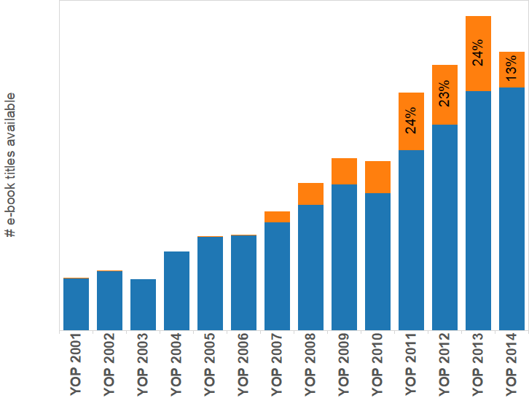
Electronic
eBook titles available in electronic format in 2014
Print still circulates, even when e is available
eBook titles that circulate in print

Slide 10
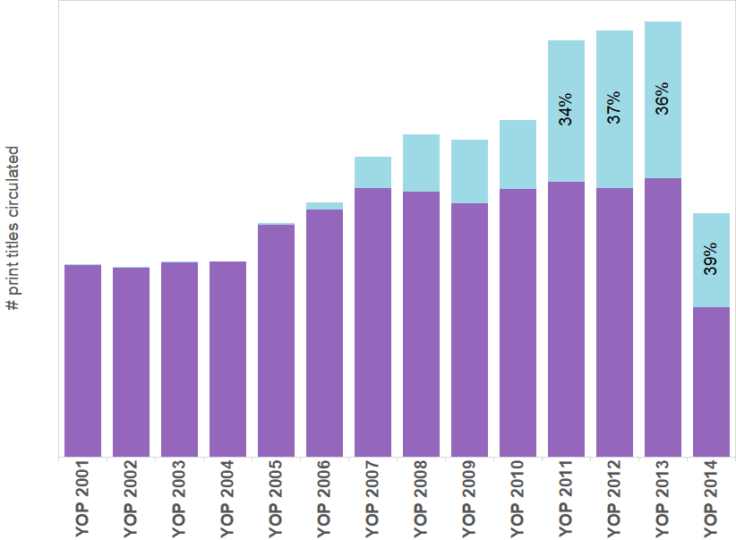
Print
Print book titles that circulated in 2014
Over 1/3 of 2011-2014 print books that circulated were available in eBook
Print books also available as eBook

Slide 11
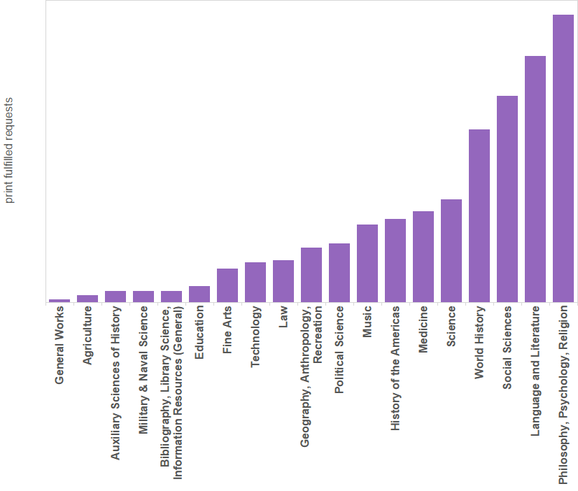
By Subject
OUP print circulation in 2014
By LC call number subject area

Slide 12
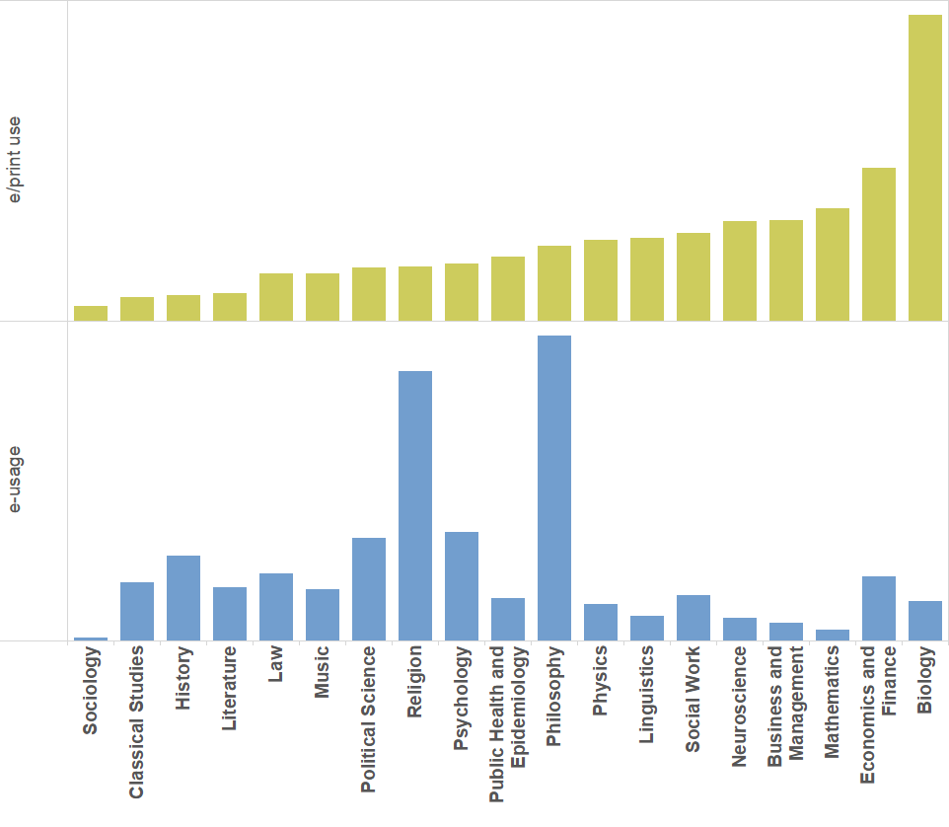
By Subject
eBook usage and e/p use ratio for titles available as eBooks in 2014
By OSO subject module

Slide 13
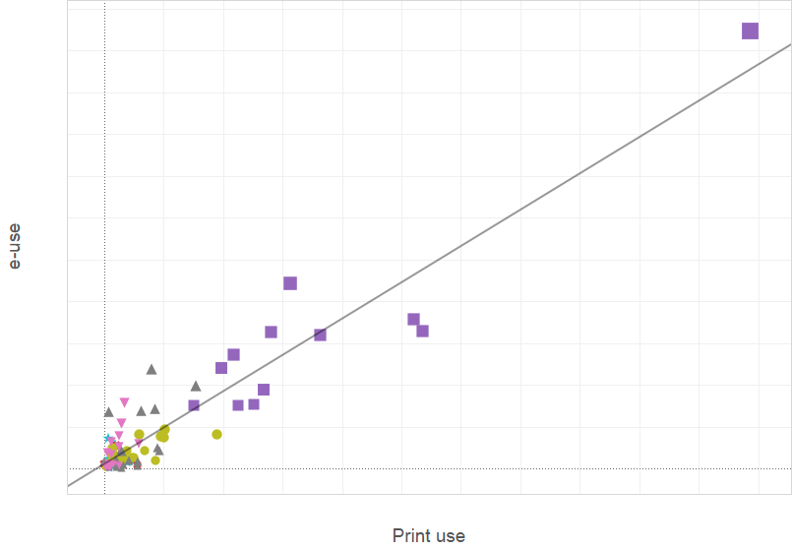
By Institution
Electronic use vs. Print use by institution in 2014
By Carnegie classification group

Slide 14
Conclusions
It can be done!
Suggests a relationship between print and electronic use
Next steps:
Other publishers – Is this specific to Oxford?
Other years – What time series trends exist?
Other factors:
Enrollment, library funding, local collections, research activity, course offerings, etc.

Slide 15
Questions?
Joanna Voss
Collections Analyst
jvoss@ohiolink.edu

